Slide 1
Solid Waste Incineration
Committee chairman
Names of committee members

Slide 2
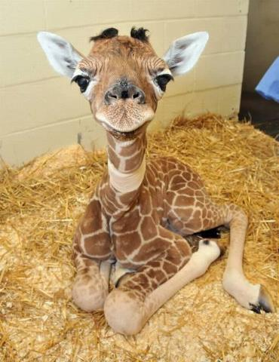
What is Waste Incineration?
Use Google to find a waste incineration image and save it to your computer.
Choose Insert > Picture from the toolbar to add your image to the slide (replace the giraffe). Make sure to give credit for the picture per your teacher’s requirements.
Add text to briefly describe solid waste incineration.
Your job is to engage and inform your audience on your topic.

Slide 3
Incineration Benefits
Benefits
Possible entries here could include:
Reduced volume of product (saves land space)
Odor-free residue
Potential energy production
Add topics and explanations as needed

Slide 4
Incineration Disadvantages
Disadvantages
Possible entries here could include:
Toxic by-products
CO₂ emissions
Expensive
Add topics and explanations as needed

Slide 5
Waste Incineration Practices
Insert no more than 6 minutes of video or parts of videos about solid waste incineration.

Slide 6
Committee’s Opinions
Summarize what your committee has learned and how your committee feels about incineration as a solution to waste management.

Slide 7
Solutions
Today
Tomorrow
1) What are the alternatives to incineration of the solid waste we already produce?
2) How are these alternatives better or worse?
3) Why do other countries choose to do more or less incineration than the U.S.?
1.)What life changes can you recommend that everyone at the Summit can consider adopting to reduce the amount of solid waste they create?

